Slide 1
Race 2
Team 8: Nick LaRosa and Nolan Sornson

Slide 2
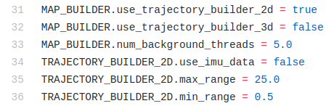
Initial Prep
VESC Calibration
MUSHR guide was for different RC car platform
Steering_angle_to_servo_gain:
Small effect on real turning radius
Large effect on perceived pose
Google Cartographer
Run Slow! (max speed = 0.6 m/s)
Set Use IMU Data to True*
2 laps
Clean up in GIMP
f110_2d.lua

Slide 3
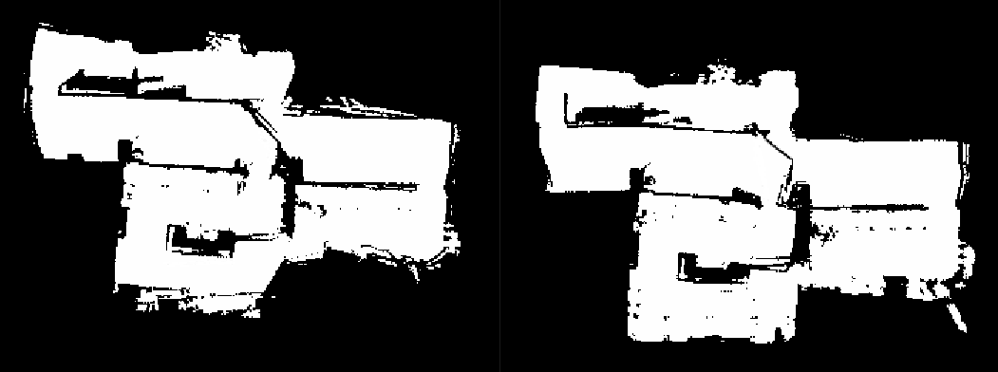
IMU Data On vs IMU Data Off
IMU Data ON
IMU Data OFF

Slide 4
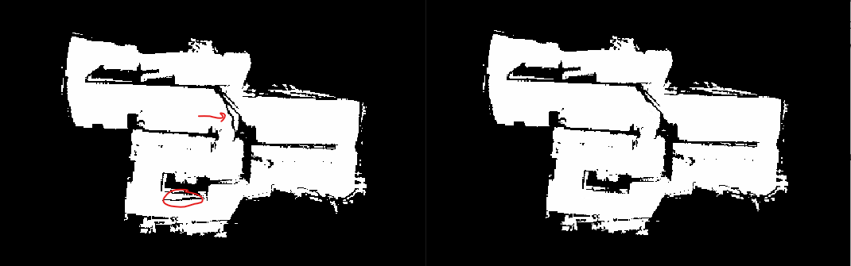
Clean up in GIMP
Before
After

Slide 5
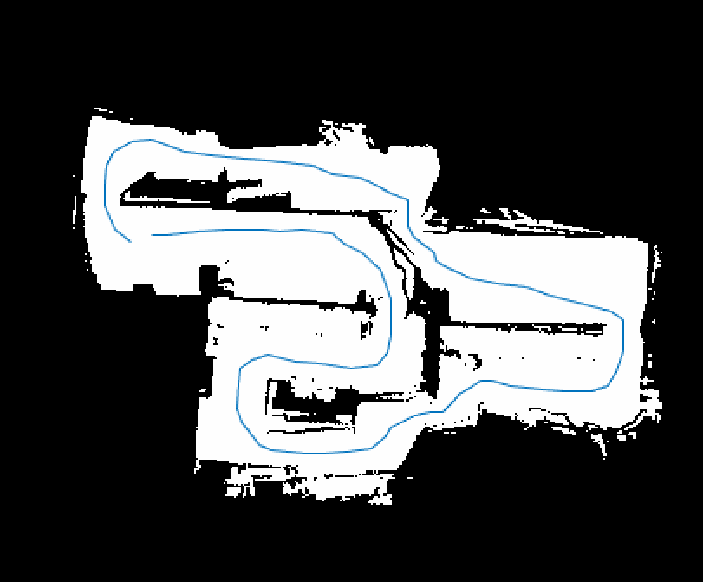
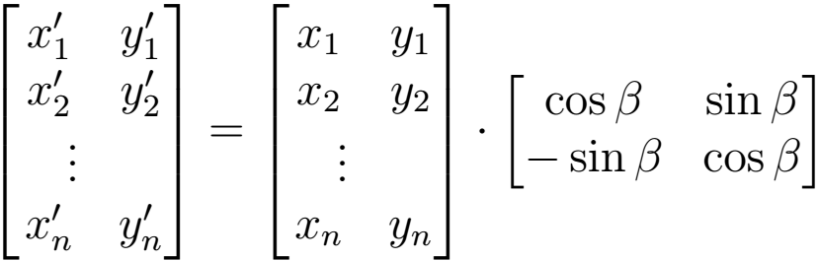
Pure Pursuit + Localization
Based on Pure Pursuit with particle filter localization
Waypoints and speeds are selected in advance and fed to the car as a 3-column CSV file
Waypoints are translated and rotated into the car frame using inverse of car’s position and rotation matrix: Where is the inverse of the car’s current heading

Slide 6
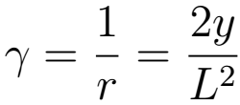
Pure Pursuit + Localization
Based on Pure Pursuit with particle filter localization
Select the first waypoint in the list as the target, set the speed as indicated (or interpolate linearly if different from the last speed), and set the steering angle proportionally to the arc calculation: Where y is the y-distance to the target waypoint and L is the overall distance

Slide 7
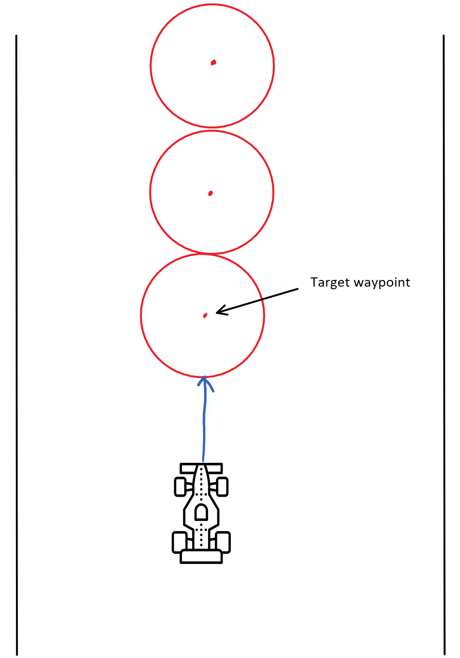
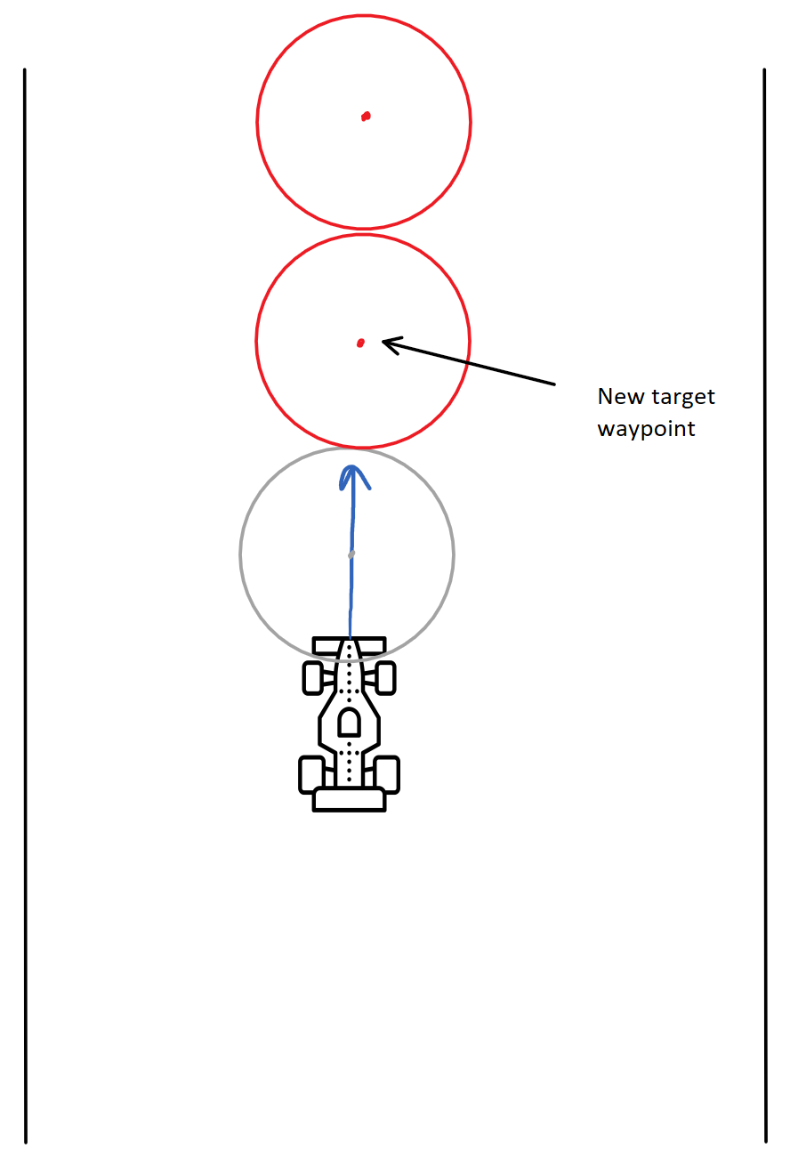
Pure Pursuit + Localization
Based on Pure Pursuit with particle filter localization
Once the distance to the first waypoint reaches the lookahead distance threshold, advance to the next waypoint (or the start of the list if we’re at the end)

Slide 8

Pure Pursuit + Localization
Odometry data alone accumulates too much error to be useful by itself in practice
Use particle filter to correct for errors:
Run particle filter alongside pure pursuit while racing
RViZ needs to be running in VNC for this to work
Change odom_topic from /odom to /pf/viz/inferred_pose
This is where the odom pose corrected using LIDAR is published by the particle filter

Slide 9


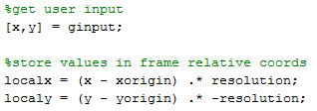
MATLAB Script
{map}.yaml: origin and resolution
Use ginput to get mouse clicks
Convert coords to car’s frame
**Highly dependent on the car begin setup at the map origin**
Relevant .yaml values
General Code Overview
Plot window output

Slide 10
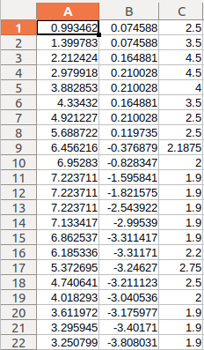
Waypoint Tuning
84 total waypoints
MATLAB Script is only good for initial setup
Fine tuning done in excel
Speed tuning could be improved
Need way to identify/number waypoints out on the map
x, y, speed up to given waypoint

